Slide 1
Literature Review 8/21
Liang-Chih Liu

Slide 2
Firm ABC
large firm / small firm
High growth firm / Low growth firm
Safe firm / Risky firm
Constrained (regulated) firm / Unconstrained firm
Investment Decision
Financing Decision
reduce the investment and financing flexibility
Restrictive covenants
Contingent-maturity mechanism
Stockholder-Bondholder Conflict
- Maximize equity value vs. Maximize total firm value
- Manager : (1) Underinvestment
[Myers 1977]
(2) Overinvestment (e.g. asset substitution)
[Jensen et al. 1976]
- Agency cost of debt
(cost incurred when suboptimal investment decisions are made
by high growth firm)
- Equity-holders have incentives to underinvest
if debt-holders share most part of the profits
from firm’s investment
(1) reduce the amount of debt
(2) issue short-term debt
or issue [1] callable bond
[2] convertible bond
(3) issue high priority debt
(4) restrictive bond covenant
- Bond-holders are afraid that equity-holders
invest in too much profitable but very risky
projects
(1) accept only higher priority bonds
(2) require restrictive bond covenants
[1] payout restriction
[2] financing restriction
[3] investment restriction

Slide 3
Financial Decision: (1) Maturity Structure (Barclay et al. 1995a )
- long term / short term
(2) Priority Structure (Barclay et al. 1995b )
- senior term / junior term
(3) Covenant Structure (Matthew et al.2007)
- [1] payout restriction
[2] financial restriction
[3] investment restriction
- event-risk covenant (poison put) (Crabbe 1991) (Cook et al. 1994)
(4) Leverage Ratio
- stationary / mean-reverting (Collin et al. 2001)
- decreasing (Longstaff and Schwartz 1995)
(5) the type of bonds
- callable/puttable/convertible
- debenture / secured bond
- sinking fund / no sinking fund
(6) Credit Rating (Darren 2006)
- investment/ below investment grade
Evaluating bond spreads concerning (1)(2)(3)(4)(5)(6)

Slide 4
(1)(2)(3)(4)(5)may interact with each other:
[1] maturity structure & priority structure (1)(2)
- There may be valuation effects that arise from deterioration in the effectively
priority of senior unsecured claims when the firm issue junior debts.
When junior issue matures prior to senior unsecured debt, the security of the senior unsecured
debt is threatened and the default risk may increase.
The empirical result shows the strongest support in cases including low rated senior
unsecured bonds. (Linn et al. (2005))
[2] maturity structure & covenant structure (1)(3)
- fewer covenants when debts have long maturity (Matthew et al.2007)
[3] maturity structure & type of bond (1)(5)
- Many debt issues have provisions that specify imbedded options to modify the repayment
schedule .
(Barclay et al. (1995))
[4] priority structure & covenant structure (2)(3)
- Covenant usage tends to increase as priority decreases
(Matthew et al.2007)
[5] covenant structure & leverage ratio (3)(4)
- Positive relation between covenant protection and leverage
(Matthew et al.2007)

Slide 5
[6] priority structure & covenant structure (2)(3)
- lower rated issues, lower priority issues and issues with change of control
provisions (i.e. poison put) tend to have more covenants of all kind.
(Matthew et al.2007)

Slide 6
event risk
- corporate restructuring
- (Ch11) debt reorganization :
(1) debt forgiveness
(2) debt restructuring and rescheduling
(3) debt conversion
(4) debt buyback and debt prepayment
- leveraged buyouts (LBO)
- leveraged recapitalization
- buy common stock
- pay dividends (dividend recapitalization)
- hostile takeover
- acquisition of large stake in firms

Slide 7
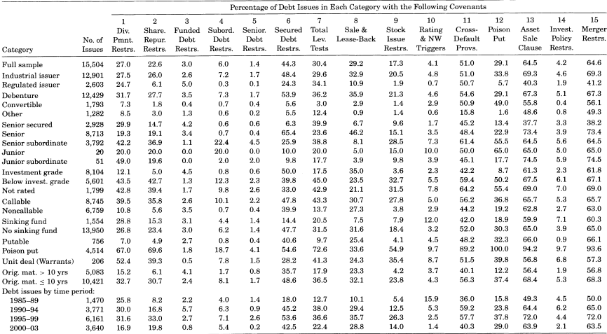
Covenant Structure
Investment policy and payout restrictions tend to be in distinct covenant groups, with each group including financing restriction.

Slide 8
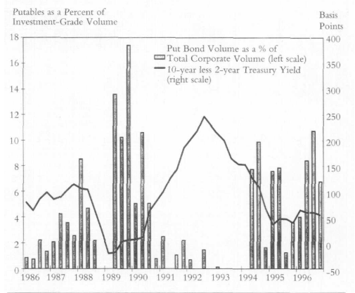
Puttable Bond Volume and Treasury Yield Curve Correlations

Slide 9
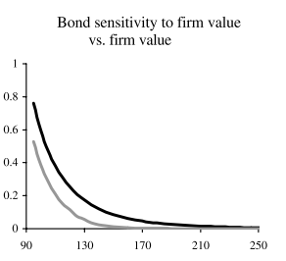
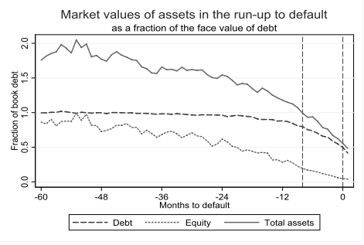
Callable bond
– mitigate the underinvestment problem (Acharya et al. (2002))
Acharya et al. (2002)
Davydenko (2006)

